Slide 1

Puerto Rico Sea Level Rise Centre – Data Portal Dashboard
Agile Sprinters

Slide 2
Team Members
Jainam Jagani Scrum Master
Veena Bathula Developer
Varsha Monala Product Owner
Ivan Francis Developer
Sai Manish Reddy Pannala Developer

Slide 3

Partners: PUERTO RICO SCIENCE, TECHNOLOGY & RESEARCH TRUST — CARIBBEAN CENTER FOR RISING SEAS
The Puerto Rico Science, Technology & Research Trust (PRSTRT) is a nonprofit organization established in 2004 under Public Law 214. Its primary mission is to foster innovation, promote the commercialization of technology, and create high-tech jobs in Puerto Rico. The Trust aims to advance the island's economy and improve the well-being of its citizens by investing in and facilitating the growth of science and technology sectors
The Caribbean Center for Rising Seas (CCRS), established in 2021 by the Puerto Rico Science, Technology & Research Trust, focuses on preparing Puerto Rico and the Caribbean for flooding risks from storms, tides, and sea level rise. CCRS aims to position Puerto Rico as a leader in climate resilience by promoting adaptive design guidelines and Safe Advanced Flood Estimates (SAFE™) to enhance coastal planning and engineering. Collaborating with experts across architecture, engineering, finance, and law, CCRS ensures infrastructure is built to withstand future flooding challenges.

Slide 4
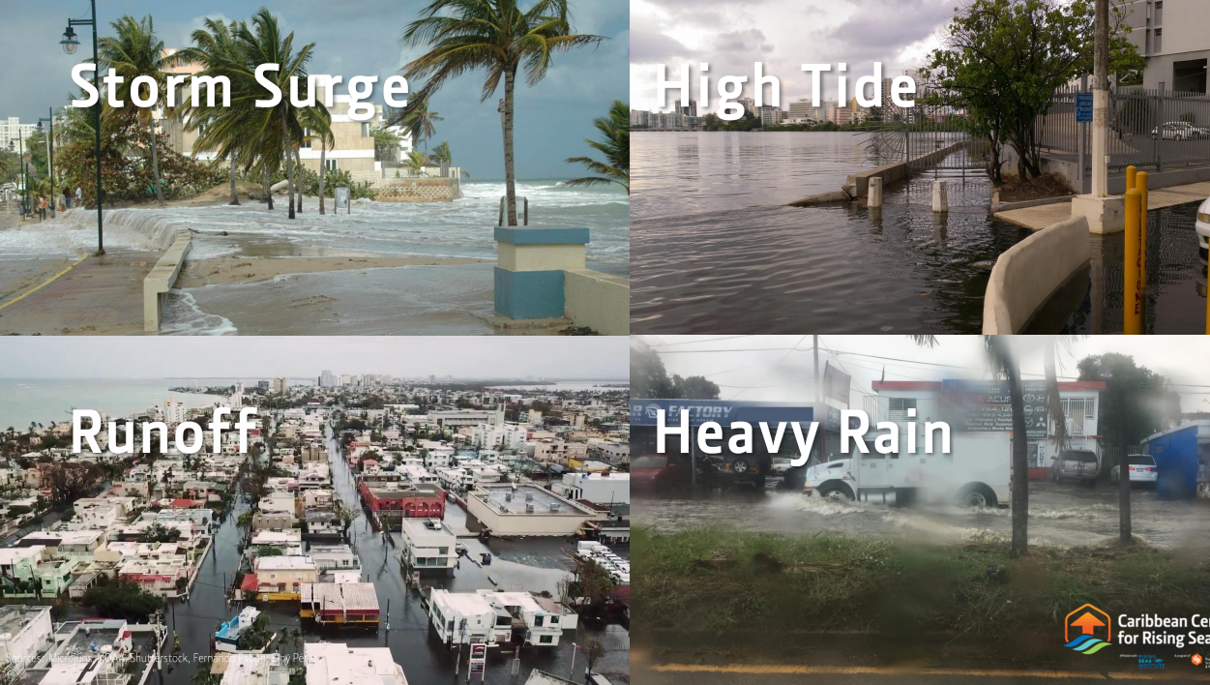
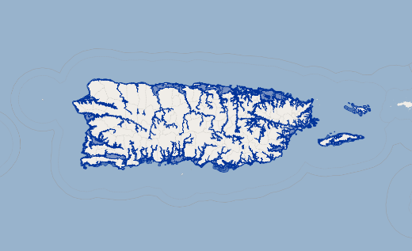
Problem Statement and Context
Problem Statement: In the context of Puerto Rico's vulnerability to natural hazards such as tsunamis, tornadoes, hurricanes, and coastal flooding, local governments face a critical challenge in prioritizing investments to safeguard public infrastructure. With limited resources, decision-makers must determine which public assets—such as hospitals, city halls, schools, law enforcement facilities, and water treatment plants—should receive priority for capital improvements and flood resilience investments.
Problem Context: This project aims to develop an interactive data dashboard that provides a ranked list of public assets based on their exposure to natural hazards. The dashboard will empower policymakers by offering actionable insights, guiding more strategic and data-driven investments to enhance infrastructure resilience and optimize resource allocation for disaster preparedness.

Slide 5
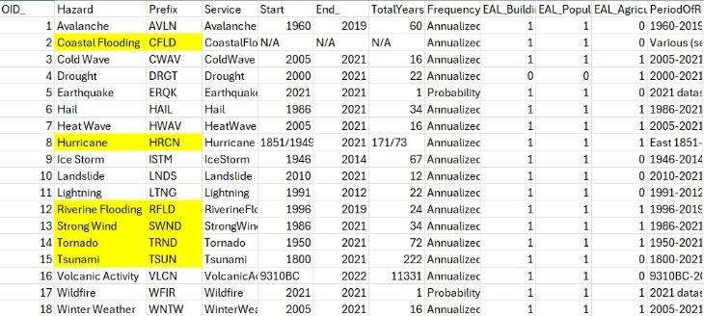
FEMA DATASET
Completeness: High completeness; all major flood zones are covered for Puerto Rico, providing a comprehensive assessment of flood risks with prediction estimates provided till 2050.
Uniqueness: Unique geographic features without duplication, as each flood zone is represented distinctly.
Accuracy: As FEMA’s data is sporadically updated and validated by federal standards it is not a highly accurate data sources due to which it has been validation through data available in NOAA.
Atomicity: With each flood zone classified independently, each data point represents a distinct hazard level.
Conformity: Consistent with federal flood zone classifications, enabling integration with other standardized datasets.
Overall Quality: Average quality; FEMA’s authoritative data supports reliable risk assessments for Puerto Rican infrastructure.

Slide 6
Internal Datasets - PRSTRT
Completeness: High completeness, covering critical infrastructure details like longitude, latitude and elevation level specific to Puerto Rico.
Uniqueness: Maintains uniqueness, with each infrastructure asset distinctly represented, avoiding duplication.
Accuracy: High accuracy, particularly useful due to local agency verification; some entries may need supplemental detail.
Atomicity: Strong atomicity, with individual attributes for each asset allowing precise vulnerability assessments.
Conformity: Conforms to local data standards, ensuring seamless integration with related datasets.
Overall Quality: Excellent quality; the internal dataset is reliable and essential for specific infrastructure insights tailored to Puerto Rico.

Slide 7
Internal Data 1:
This dataset provides information on critical infrastructure in Puerto Rico, mapping out assets like airports, schools, substations, hospitals, and more, and their projected exposure to rising sea levels.
Importance:
Risk Assessment
Infrastructure Vulnerability Mapping
Critical Decision-Making for Emergency Response
Climate Change Adaptation Planning
Resource Allocation
objectid | level | layer_name | x | y
1 | 10 ft | Aeropuerto | -65.3036 | 18.31162
96 | 7 ft | Escuelas | -66.0461 | 18.43311
276 | 3 ft | Iglesias | -65.8611 | 18.42186
292 | 10 ft | Plantas Generadoras | -65.3023 | 18.30487
341 | 7 ft | Subestaciones | -65.577 | 18.11872
407 | 3 ft | Antennas | -66.41 | 18.4608
525 | 1 ft | Infraestructura Histórica | -66.0842 | 18.46282
552 | 10 ft | Hospitales | -66.0831 | 18.42168

Slide 8
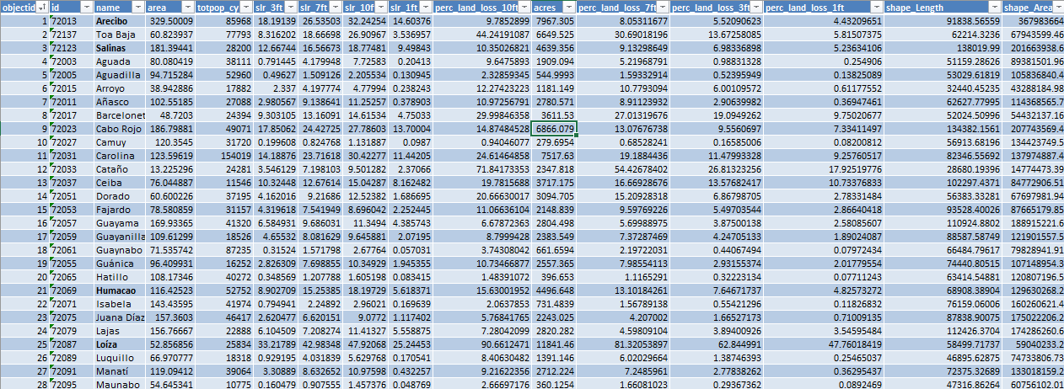
Internal Data 2:
The dataset analyzes the potential impacts of sea level rise at different elevations (1ft, 3ft, 7ft, and 10ft) across various municipalities in Puerto Rico. A total of 45 municipalities were analyzed in this dataset.
Importance:
Risk Assessment
Urban Planning
Informed Decision-Making
Data-Driven Solutions

Slide 9
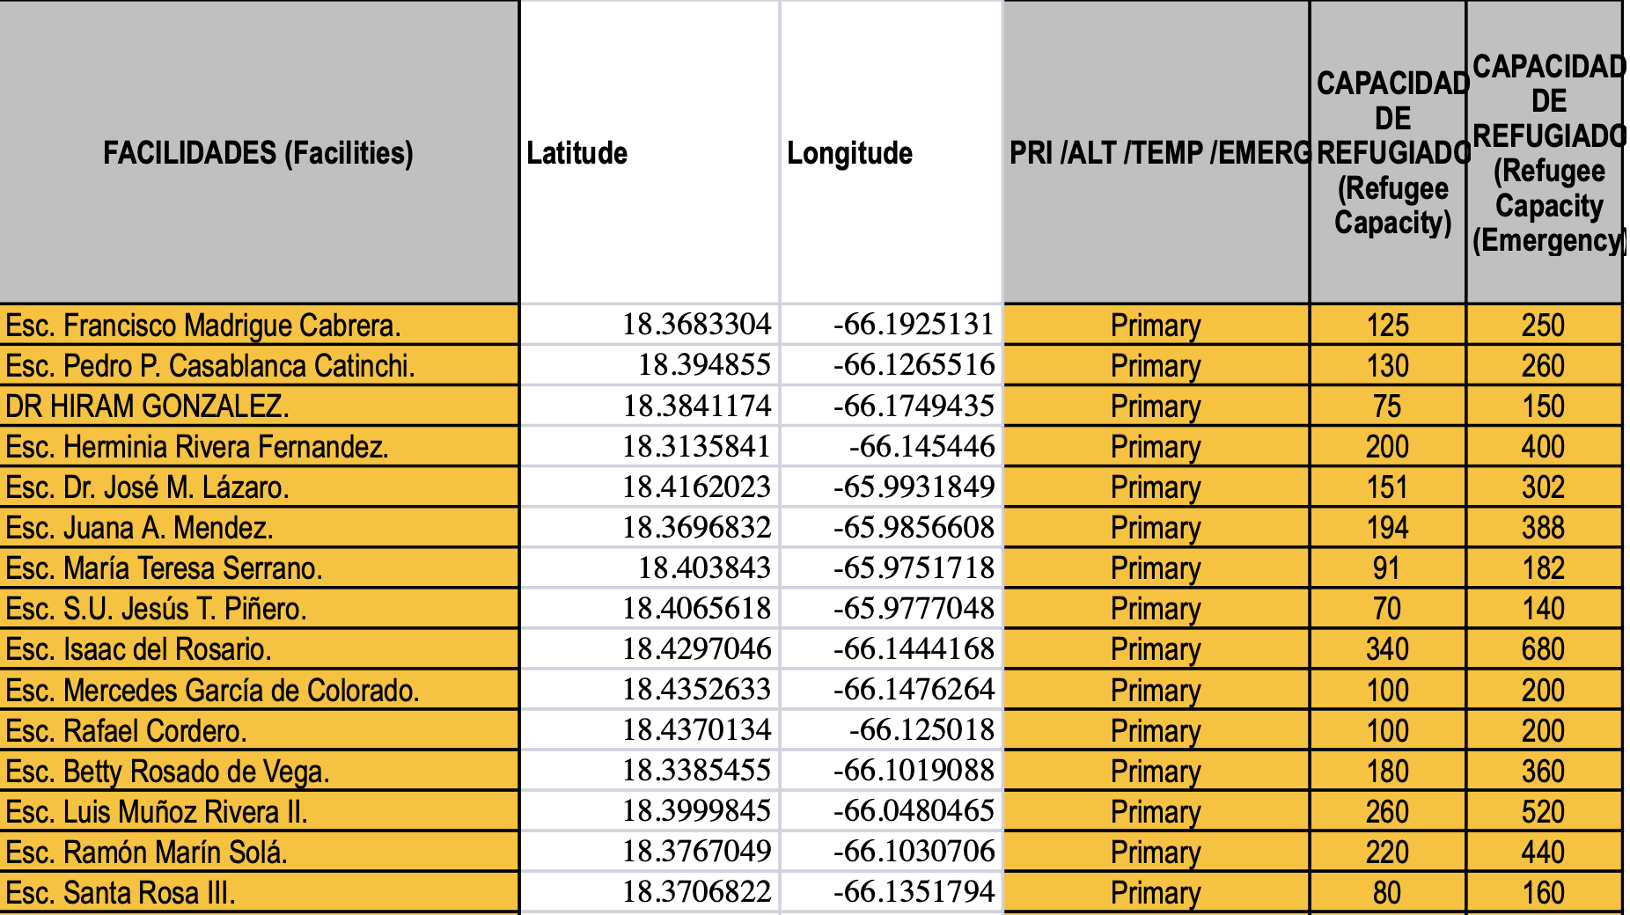
School Shelters Data
The school shelters dataset maps Puerto Rico's disaster response infrastructure, focusing on the distribution, categorization, and capacity of school facilities designated as shelters. It highlights shelter accessibility, preparedness, and potential gaps, aiding disaster management strategies.

Slide 10
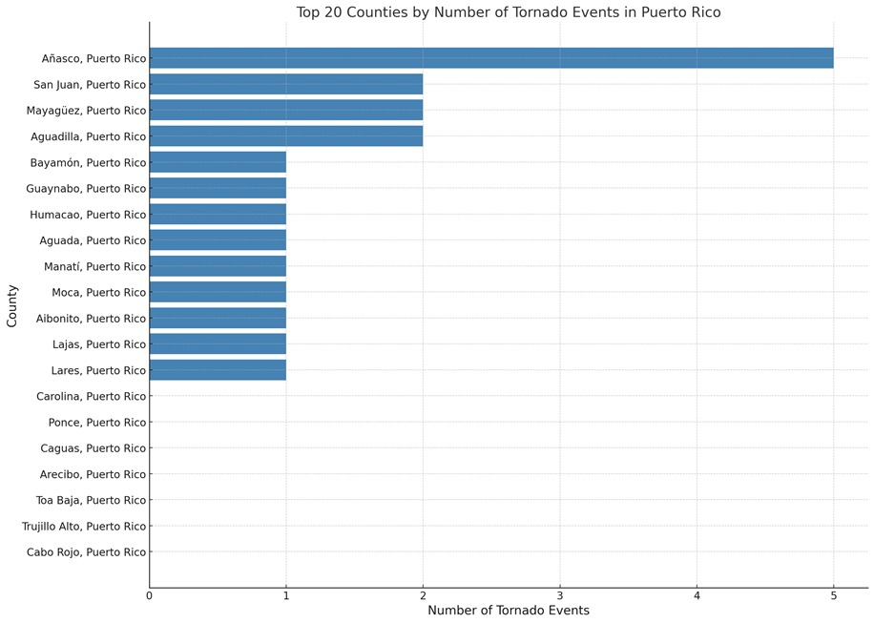
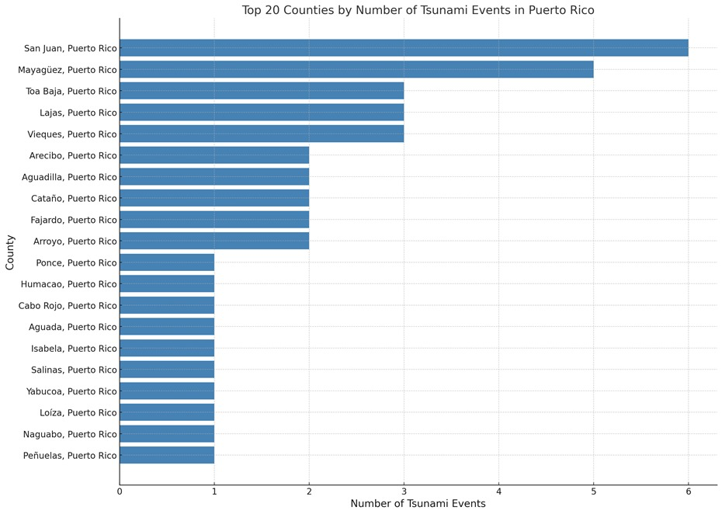
Visualizations – FEMA Data

Slide 11
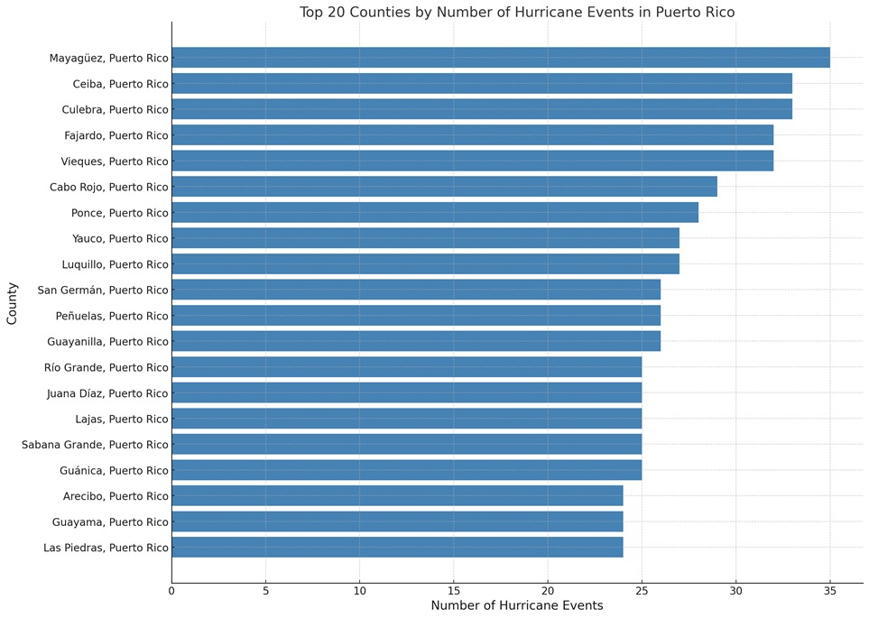
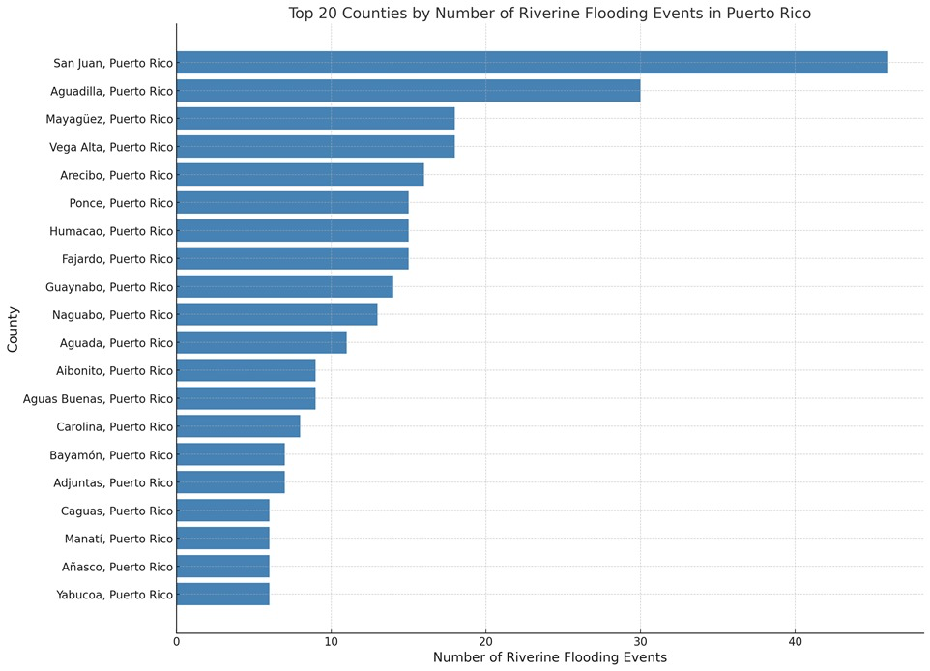
Visualizations – FEMA Data

Slide 12
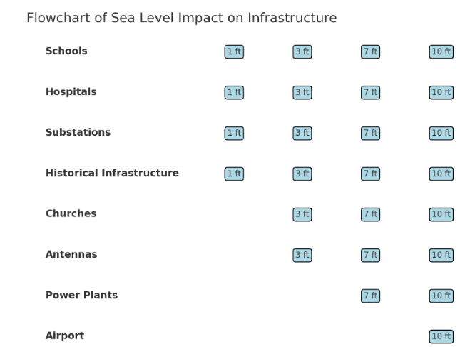
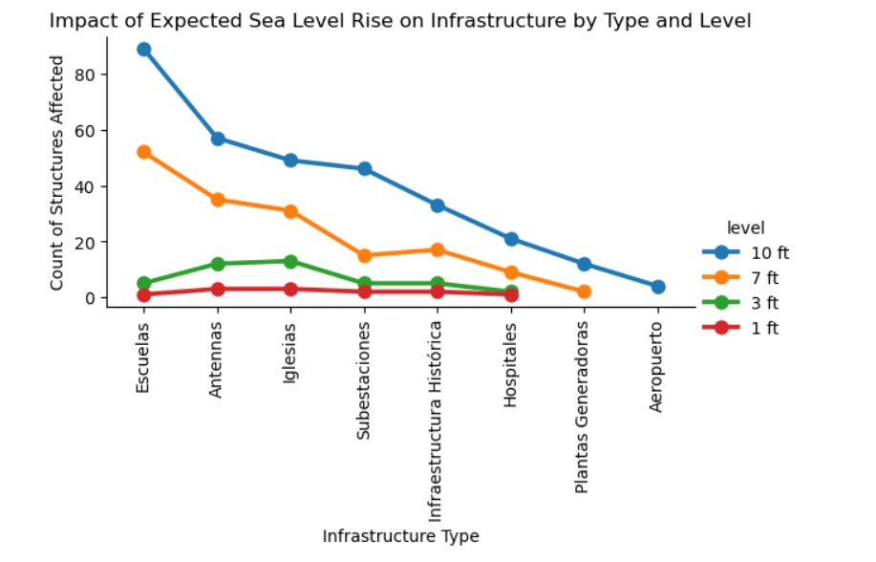
Visualizations – Internal Data

Slide 13
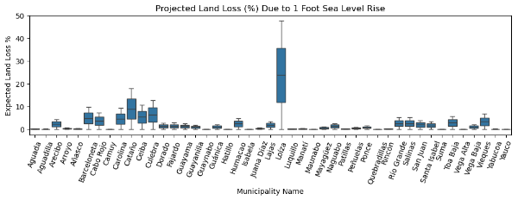
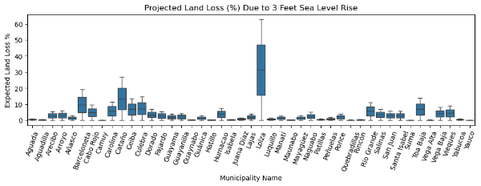
Visualization – Internal Data
Loíza experiences the highest expected land loss at 47.76%, and municipalities like Vega Alta, Quebradillas, and Hatillo are projected to face minimal land loss, with values around 0.07% to 0.38%.
The municipality of Loíza is expected to experience the highest land loss, with approximately 62.8% of its area at risk due to a 3-foot rise in sea levels while the municipalities such as Quebradillas, Camuy, Yauco, and Suma have lowest expected land loss, ranging from 0.2% to 1.7%.

Slide 14
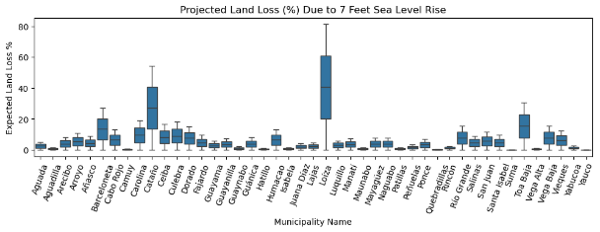
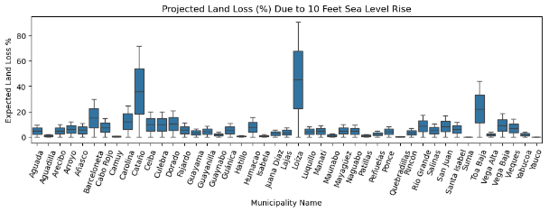
Visualizations – Internal Data
Loíza experiences the highest expected land loss, with 81.32% of its land being at risk. Hatillo, Maunabo, and Quebradillas report the lowest land loss percentages, with values under 5%.
Loíza is expected to experience the highest land loss at 90.66% and Vega Alta (0.15%) shows the lowest expected land loss, indicating this municipality is less vulnerable to a 10-feet sea level rise.

Slide 15
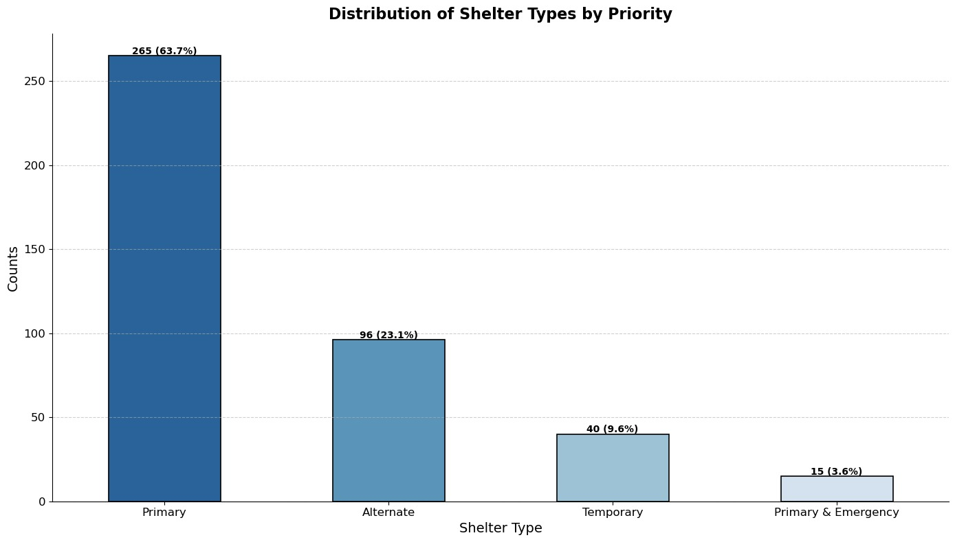
Visualizations – School Shelters Data

Slide 16
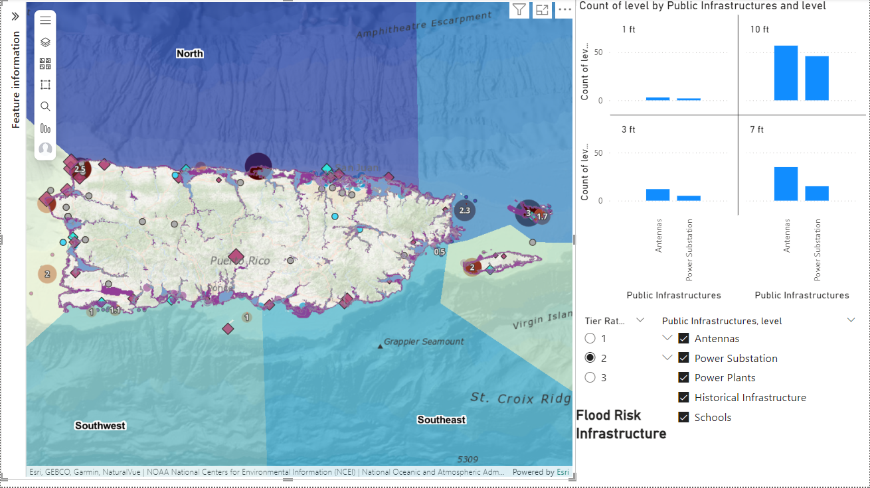
Visualizations – Infrastructure Data

Slide 17
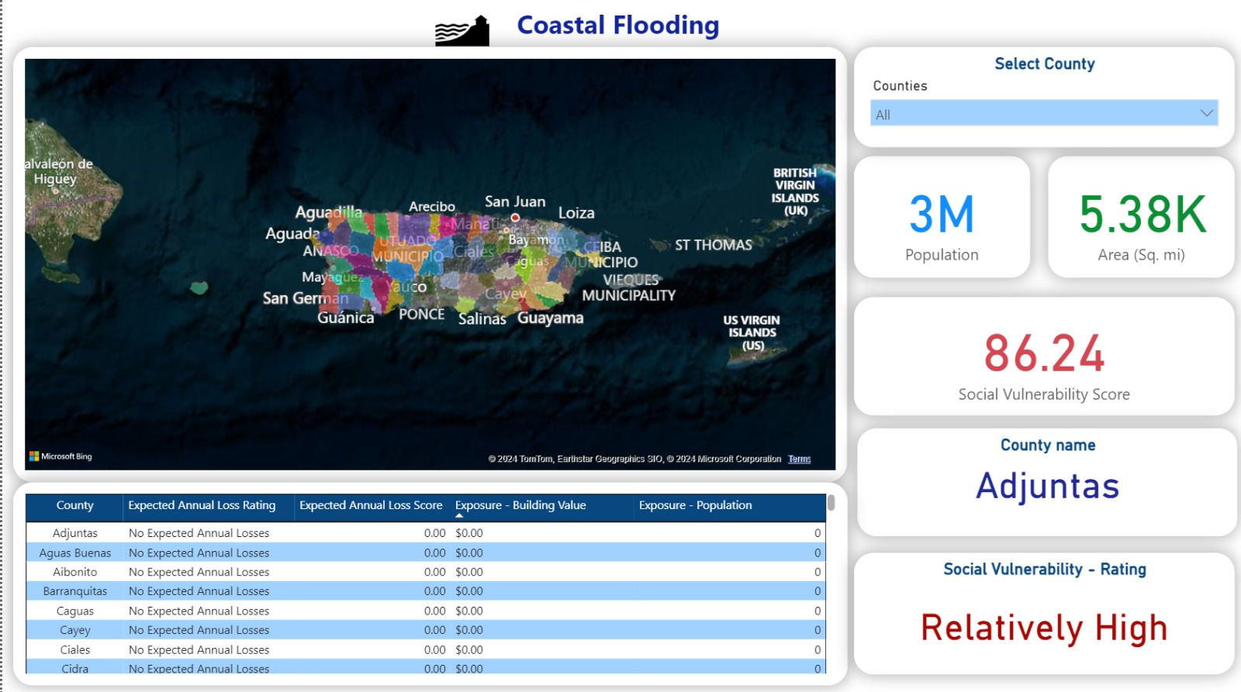
Visualizations – Natural Risk Index by County

Slide 18
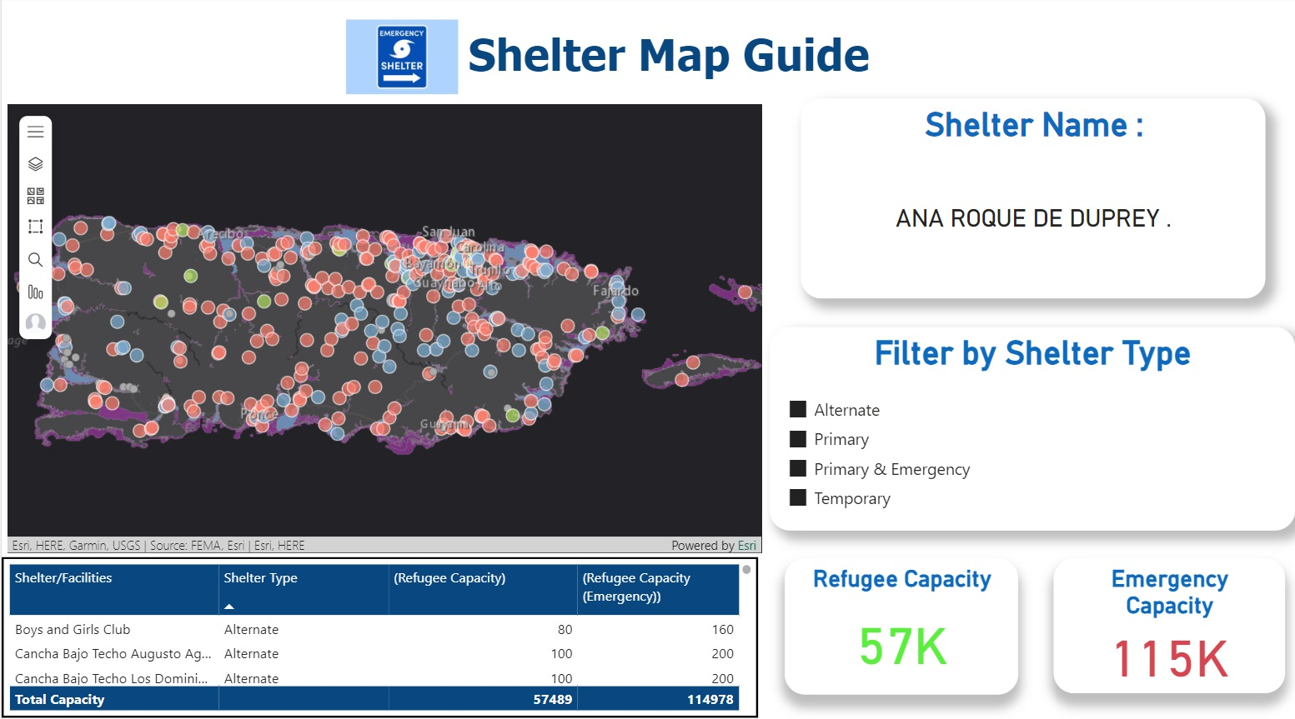
Visualizations – Shelter Map Guide

Slide 19
Summary
The Puerto Rico Sea Level Rise Center - Data Portal Dashboard is a pivotal advancement in managing climate-related risks. It empowers stakeholders with precise, actionable data to build.
The dashboard leverages Power BI technology to integrate and visualize data from FEMA and internal datasets concerning the impact of sea level rise on critical infrastructure and municipalities in Puerto Rico. This tool dynamically maps out vulnerabilities and forecasts potential damage under various sea level rise scenarios, providing a geographical scope and statistical analysis of risk.
Key Features:
Enhanced Data Accuracy and Coverage: Improved quality checks and the integration of multiple data sources ensure a comprehensive and accurate assessment of risks.
User-Friendly Visualization: The Power BI implementation makes complex data accessible and interpretable for various stakeholders, promoting wider usability and application.
Strategic Resource Allocation: The dashboard aids in optimizing resource allocation by highlighting critical areas needing immediate attention, thus improving efficiency in disaster preparedness and climate adaptation efforts.
Adaptability and Scalability: Designed to easily incorporate additional data, the dashboard can adapt to new research findings and expand to include other natural hazard assessments.

Slide 20

Future Scope
Incorporate additional datasets such as climate projections from NASA and NOAA to enhance predictive capabilities.
Include economic and demographic data to further analyze the socio-economic impacts of sea level rise.
Upgrade the dashboard for real-time data processing and alerts.
Collaborate with policymakers to integrate dashboard insights into national and regional planning documents.
Develop guidelines for infrastructure development and urban planning that consider long-term climate risks.
Regularly update the dashboard to reflect the latest research and data.

Slide 21

Questions?

